Slide 1
Course Instructor: Nida Munawar
Email Address: nida.munawar@nu.edu.pk
Reference Book: Applying UML and Patterns (An introduction to Object-Oriented Analysis and Design And Iterative Development)
BY Craig Larman
Third Edition
Software Analysis and Design (CS:3004) Activity Diagram

Slide 2
Objectives:
Discuss and understand activity diagrams
Understand the elements of activity diagrams
Activity
Transition
Synch. Bar
Decision Diamond
Start & Stop Markers
What is an activity diagram?
Example: Student Enrollment in IIT (SEIIT)
Activity diagram for a use case in SEIIT
Basic components in an activity diagram and their notations
Managing the large activity diagram: Swim Lane
Activity diagram vs. Flow chart

Slide 3
A Quick Recall…
Behavioral UML diagrams, These UML diagrams visualize how the system behaves and interacts with itself and with users, other systems, and other entities.(What must happen in a system)
Structural UML diagrams, as the name would suggest, show how the system is structured, including the classes, objects, packages, components, etc. in the system and the relationships between those elements.(What is contained in a system)

Slide 4
What is an Activity Diagram?
Represent the dynamic (behavioral) view of a system
Used for business (transaction) process modeling
Used to represent flow across use cases or within a use case
UML activity diagrams are the object oriented equivalent of flow chart and DFDs in function-oriented design approach
Describes how activities are coordinated.
Records the dependencies between activities, such as which things can happen in parallel and what must be finished before something else can start.
Represents the workflow of the process.
Activity diagram contains activities, transitions between activities, decision points, synchronization bars, swim lanes and many more.

Slide 5
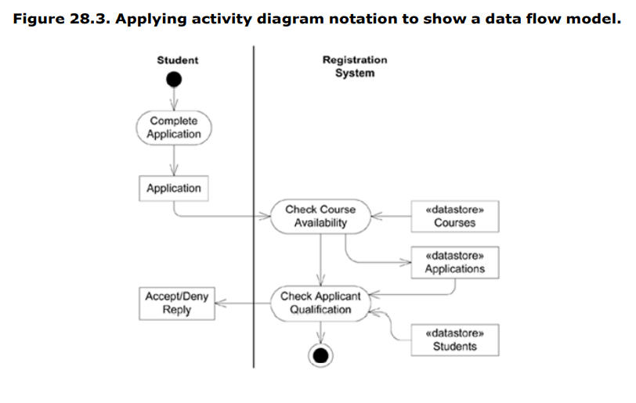
DFD using Activity Diagram
Fortunately, UML activity diagrams can satisfy the same goals they can be used for data flow modeling, replacing traditional DFD notation.

Slide 6





Notation 1 and 2
2. Transition
Activity1
Activity2
1. Activities

Slide 7




Notation - 3
[x>0]
[x>0]
Activity1
[x=0]
[x=0]
[x<0]
[x<0]
3. Decision Diamond

Slide 8


Notation - 4
4.1 Synch. Bar (Join)
4.2 Splitting Bar (Fork)

Slide 9



Notation - 5
Start Marker
Stop Marker
5. Start & Stop Markers

Slide 10
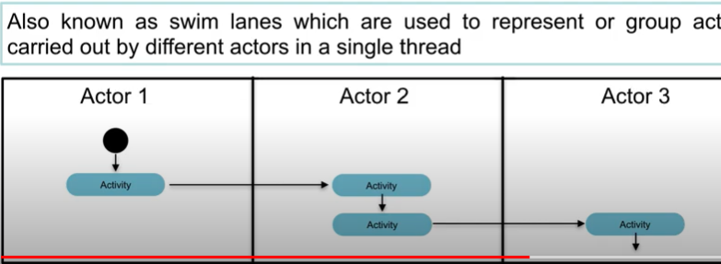
Notation-6
6.Partition

Slide 11

Must be true before moving to the next activity

Slide 12
Activity Diagrams (1)
To model the dynamic aspects of a system
It is essentially a flowchart
Showing flow of control from activity to activity
Purpose
Model business workflows
Model operations

Slide 13
Activity Diagrams (2)
Activity diagrams commonly contain
Activity states and action states
Transitions
Objects

Slide 14
Action States and Activity States
Action states
Represents the execution of an atomic action, typically the invocation of an operation.
Work of the action state is not interrupted
Activity states can be further decomposed
Their activity being represented by other activity diagrams
They may be interrupted
 ActionState has is replaced, in UML 2.0, by Action.

Slide 15
Transitions (1)
When the action or activity of a state completes, flow of control passes immediately to the next action or activity state
A flow of control has to start and end someplace
initial state -- a solid ball
stop state -- a solid ball inside a circle

Slide 16
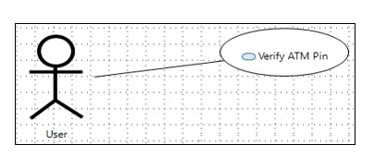
convert use case diagram to activity diagram
A UML activity diagram helps to visualize a certain use case at a more detailed level. It is a behavioral diagram that illustrates the flow of activities through a system.
Activity diagram for ATM Verify

Slide 17
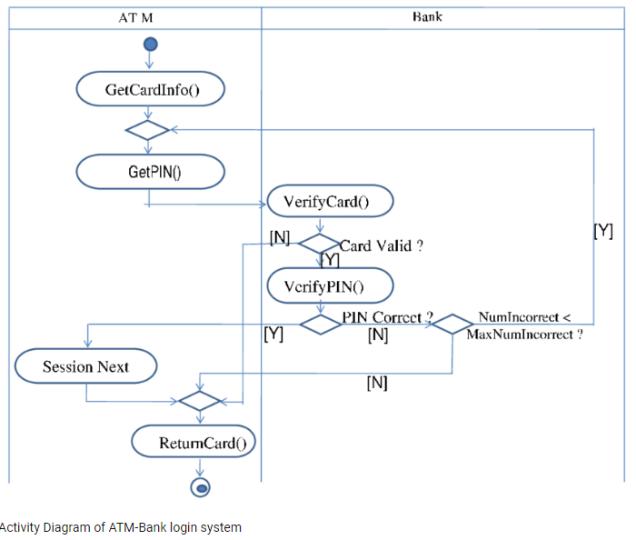
Activity diagram for ATM Verify

Slide 18
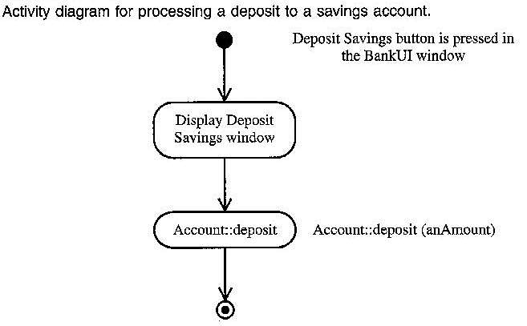
Activity Diagram: Example (1)

Slide 19
Branching (1)
A branch specifies alternate paths taken based on some Boolean expression
A branch may have one incoming transition and two or more outgoing ones

Slide 20
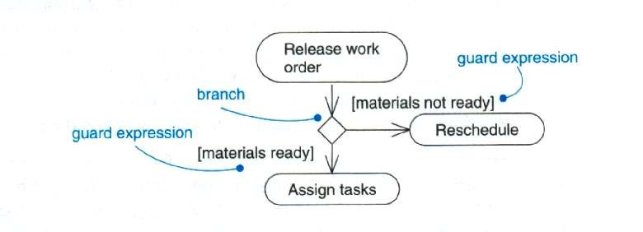
Branching (2)

Slide 21
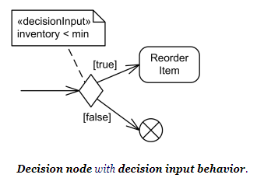
Decision input behavior
is specified by the keyword «decisionInput» and some decision behavior or condition placed in a note symbol, and attached to the appropriate decision node.

Slide 22

Class Activity:
Identify the activities performed by an ATM user in an ATM system.

Slide 23
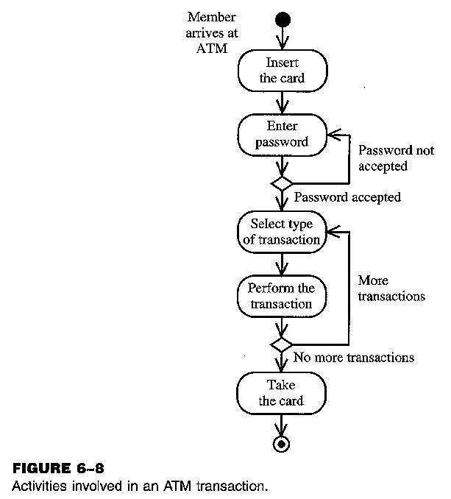
Activity Diagram: Example (2)

Slide 24
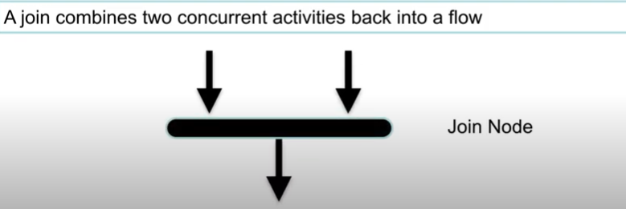
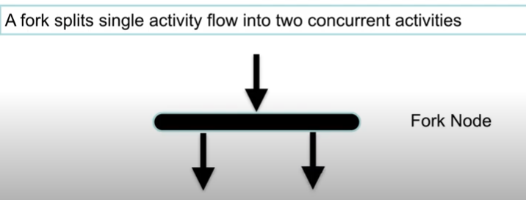
Forking and Joining
Use a synchronization bar to specify the forking and joining of parallel flows of control
A synchronization bar is rendered as a thick horizontal or vertical line
. The actions are executed concurrently, although they can also be executed one by one. The important thing is that all the parallel edges be performed before they unite

Slide 25
Fork
A fork may have one incoming transitions and
two or more outgoing transitions
each transition represents an independent flow of control
conceptually, the activities of each of outgoing transitions are concurrent
either truly concurrent (multiple nodes)
or sequential yet interleaved (one node)

Slide 26
Join
A join may have two or more incoming
transitions and one outgoing transition
above the join, the activities associated with each of these paths continues in parallel
at the join, the concurrent flows synchronize
 each waits until all incoming flows have reached the join, at which point one flow of control continues on below the join

Slide 27
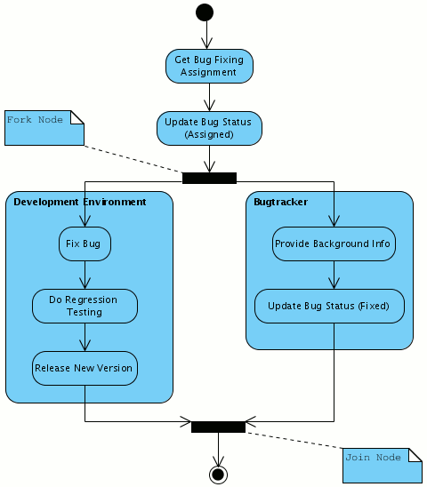
Parallel Activities: Forking and Joining

Slide 28
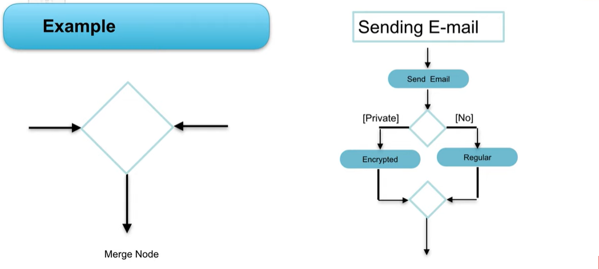
Merge
Two activities are merged with condition and only one activity flows forward
Rejoins mutually exclusive execution path(activities that can not happen concurrently)
Merge node is a control node that brings together multiple incoming alternate flows to accept single outgoing flow. There is no joining of tokens. Merge should not be used to synchronize concurrent flows.

Slide 29
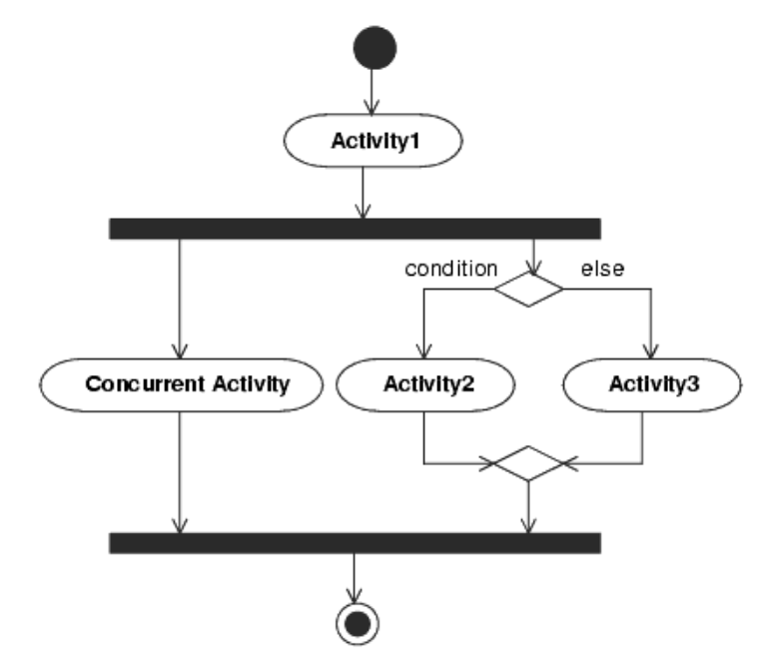
For example, if a decision is used after a fork, the two flows coming out of the decision need to be merged into one before going to a join; otherwise, the join will wait for both flows, only one of which will arrive.

Slide 30
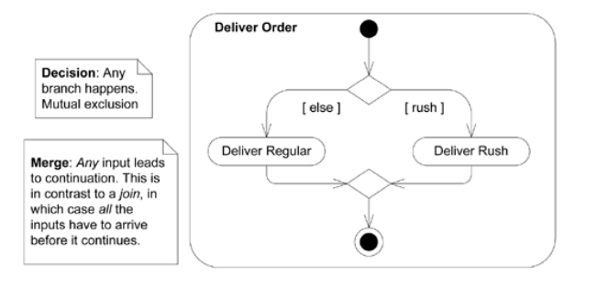

Slide 31
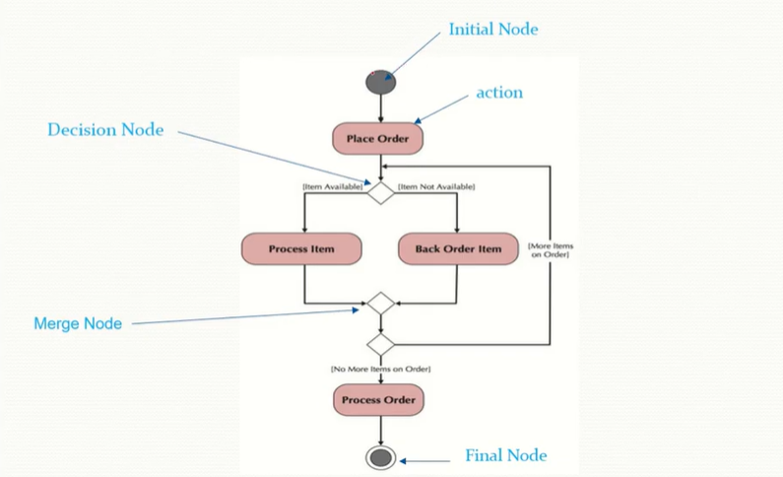

Slide 32
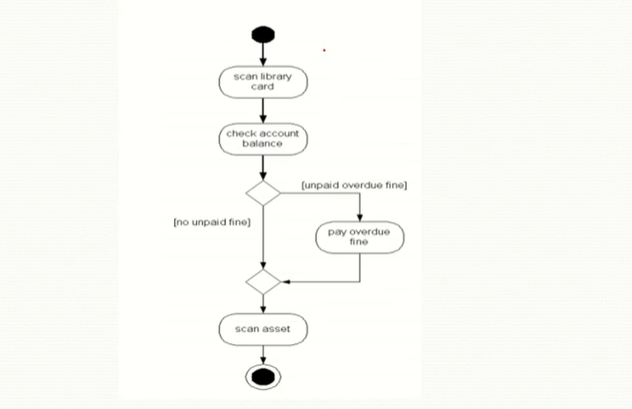

Slide 33
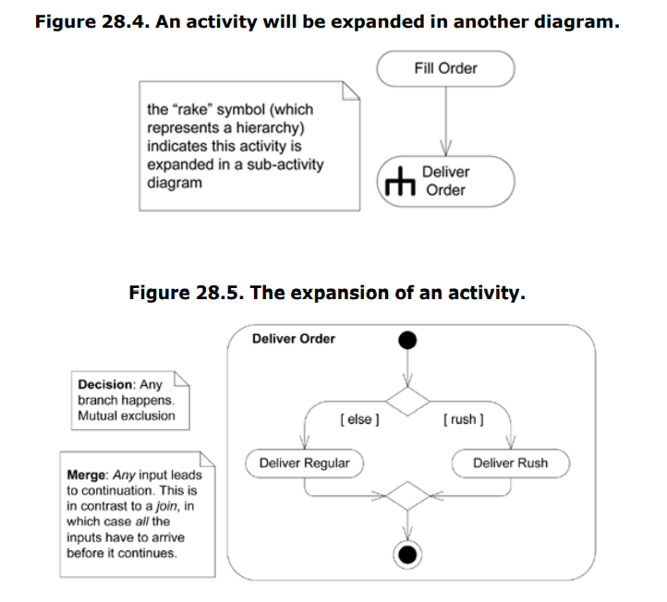
How to show that an activity is expanded in another activity diagram?
using the rake symbol.

Slide 34
Basic Components in an Activity Diagram
Difference between Join and Merge
A join is different from a merge in that the join synchronizes two inflows and produces a single outflow. The outflow from a join cannot execute until all inflows have been received
A merge passes any control flows straight through it. When all incoming flow reach this point then processing continues

Slide 35
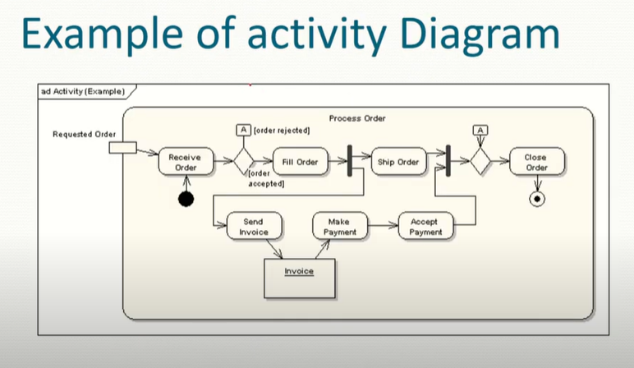

Slide 36
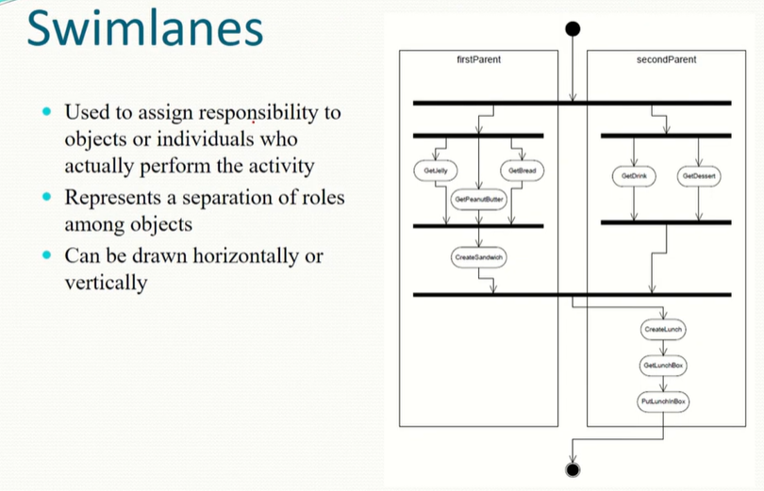

Slide 37
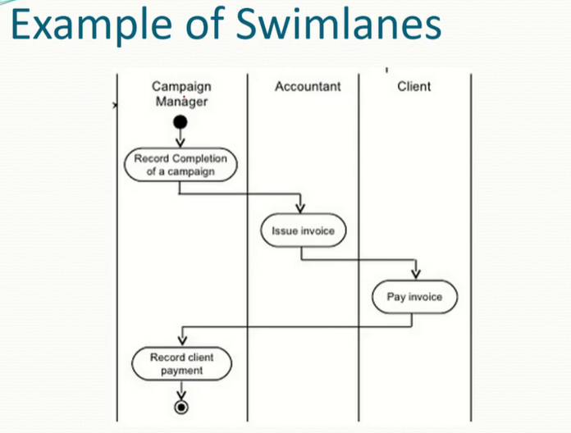

Slide 38
Swimlanes
A swimlane delineates who does what in a process.
To partition the activity states on an activity diagram into groups
each group representing the business organization responsible for those activities
each group is called a swimlane
It provides clarity and accountability by placing process steps within the horizontal or vertical “swimlanes” of a particular employee, work group or department.

Slide 39
Swimlanes
Each swimlane has a name unique within its
diagram
Each swimlane may represent some real-world entity
Each swimlane may be implemented by one or more classes
Every activity belongs to exactly one swimlane, but transitions may cross lanes

Slide 40

Some more features in Activity Diagrams

Slide 41
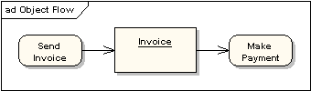
Object and Object Flow
There is no data flow in activity diagram. Object flow plays role of data flow as well.
An object flow is a path along which objects can pass. An
object is shown as a rectangle
An object flow is shown as a connector with an arrowhead denoting the direction the object is being passed.

Slide 42

Input and Output Pin
 An object flow must have an object on at least one of its ends.
A shorthand notation for the above diagram would be to use input and output pins

Slide 43
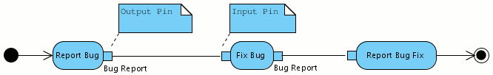
Passing Objects Between Actions
 Objects in the UML language hold information - state - that is passed between actions. Objects may represent class instances:
 Objects usually change state between actions:
 An alternative notation shows action input pins and output pins.
These emphasize that the corresponding object is required while
object nodes rather emphasize the existance of that object:

Slide 44
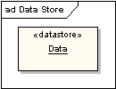
Data Store
 A data store is shown as an object with the «datastore»
keyword

Slide 45
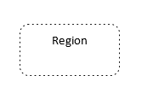
Expansion Region:
On an Activity diagram, sometimes the output of an action can trigger multiple invocations of another action when this happens it's helpful to use an expansion region in your activity diagram.
An expansion region shows a set of actions that occur once for each item in a collection so an expansion region contains some process that acts multiple times on the incoming data once for each element in the input collection it may be helpful to think of an expansion region as behaving like a for loop over the input collection.

Slide 46
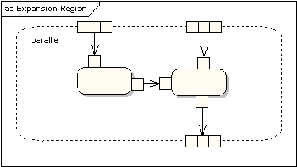
Expansion Region
Expansion regions and structured activities provide mechanisms to show the strategy for managing the synchronization issues in a real- time system.
An expansion region is a structured activity region that executes multiple
times for collection items.
Input and output expansion nodes are drawn as a group of three / four boxes representing a multiple selection of items. The keyword iterative, parallel or stream is shown in the top left corner of the region

Slide 47
Interaction Types:
Iterative: when your expansion region is iterative the executions happens in sequence (One item at a time)
Parallel: when your expansion region is parallel it means your interactions are independent and can happen concurrently
Streams: All the input elements enters the expansion region at the same time so they come in all at once and the expansion region can operate on the collections as the whole

Slide 48
Iterative:
Example:
Imagine a car rental agency and when cars are returned to this agency they collect a batch of cars and then they send those cars through their one lane car wash one at a time so our action that would trigger this multiple invocation of the carwash would be receive returned cars and once they've received batch of cars they're going to send them one at a time through the carwash and so that will be our expansion region

Slide 49
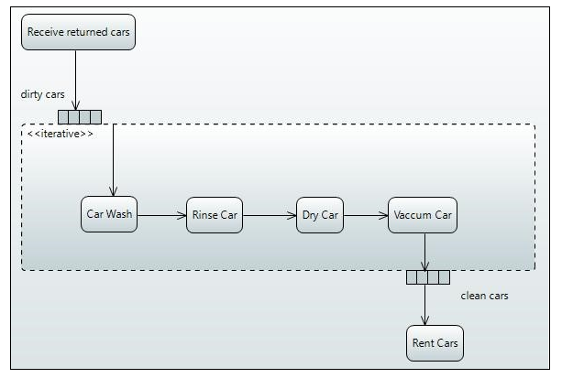

Slide 50
Expansion Region: Application-processing:
The organization must accept an electronic application, review the eligibility of the application, store the application, and then confirm receipt of a valid application.

Slide 51
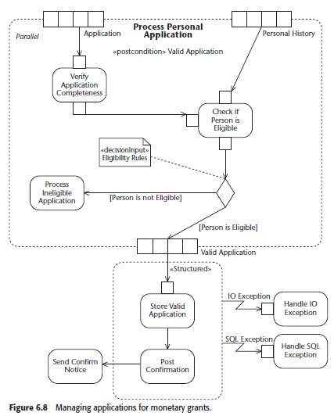
Parallel

Slide 52
Continue..
The top section on the diagram shows an expansion region, a type of structured activity that handles the input and output of collections with multiple executions.
The collection as two sets of four boxes on the top and one at the bottom showing the application, the personal information, and the verified applications.
The italicized word in the upper-left corner shows that this expansion
region allows multiple executions to the actions to occur in parallel.
The action executions do not have to follow any ordering on the entering
collections.
You can also use iterative to show the region only allows one set of actions to execute at a time or streaming to show execution in the order of the collection.
The system also relies on information from a database about the person.
When combined with the eligibility rules for the application, shown on the diagram as a <<decisionInput>>, the organization filters out ineligible applications and sends the application on for storage.

Slide 53
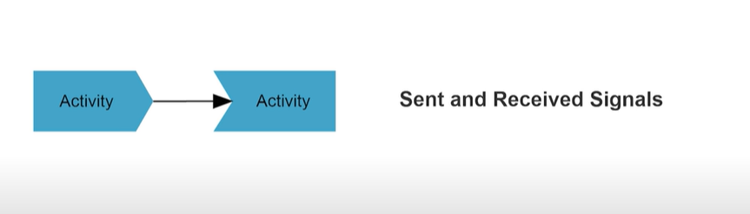
signals
They usually appear in pairs because the state can't change until the response is received
e.g., an authorization of payment is needed before the order is completed
Input/Receive signal : Initiate a particular action
Output/Send signal : waits until the response is received
Concave pentagon = receive signal
Context pentagon= send

Slide 54
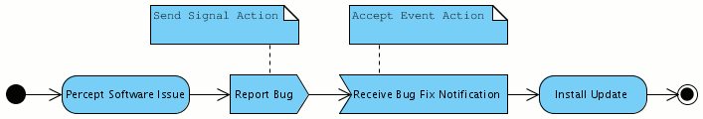
Interacting with External Participants
External participants may be external processes, systems, or people, interacting with an activity.
A receive signal "wakes up" an action that is "sleeping“.
A send signal is sent to an external participant.
In the following diagram, both a send and receive signal action are used.
 Note that the activity flow gets interrupted - gets into a wait state - until the bug fix notification is received. (If there was no receive signal action, however, the flow would just continue after executing the send signal action.)

Slide 55

Interacting with External Participants
 An activity may also start with a receive signal node:

Slide 56

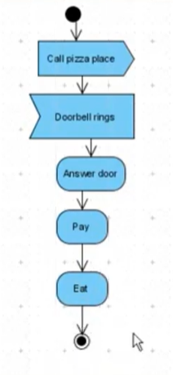

Slide 57
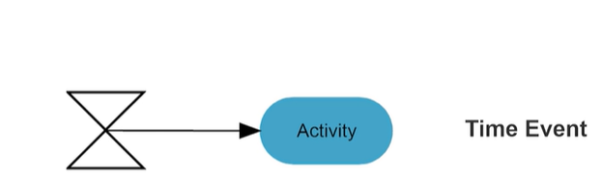
Time Event
Stops the flow for a period(depicted as an hour class)

Slide 58
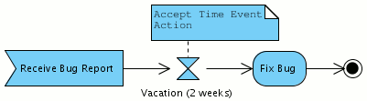

Time Events
 A time event models a wait period:
 An activity starting with a time event is launched periodically:

Slide 59
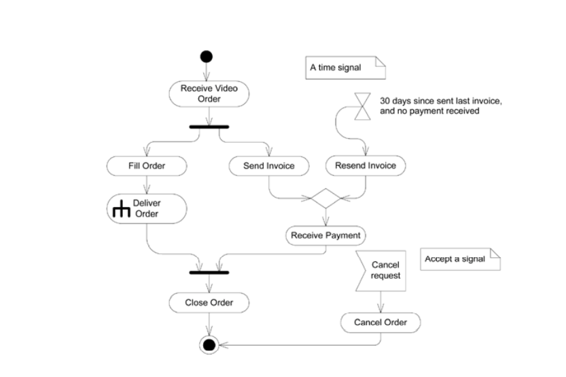
when you need to model events such as time triggering an action, or a cancellation request.

Slide 60
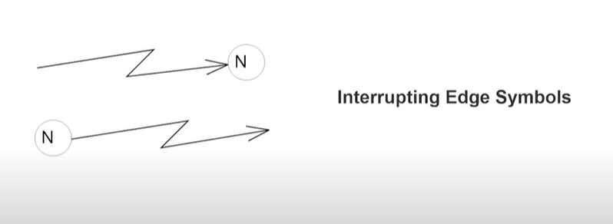
Interrupting an Activity
Interrupts a flow e.g., cancellation
Represented with Zigzag arrow
It looks like exception handler but in this context, we call it an interrupting edge

Slide 61
Interruptible Activity Region
An interruptible activity region is represented by Activity box with the dashed lines
The actions that are interrupted must be placed inside the interruptible activity region
The event that could cause the interruption as also placed inside the interruptible activity region
When the interruption happens, we bypass all the actions and moves towards the end

Slide 62
As you diagram a processor activity you may find that an action or a group of actions can be interrupted by some event to show this use an interrupted activity region an interruptible activity region is represented by an activity box with a dashed line border.

Slide 63
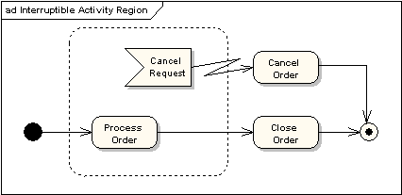
Interruptible Activity Region
 An interruptible activity region surrounds a group of actions that can be interrupted. In the very simple example below, the Process Order action will execute until completion, when it will pass control to the Close Order action, unless a Cancel Request interrupt is received which will pass control to the Cancel Order action

Slide 64
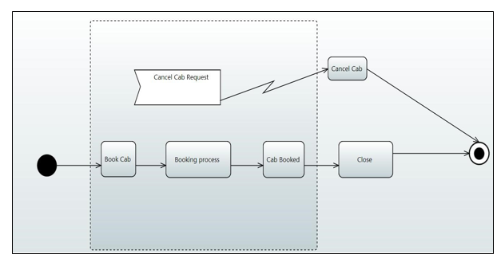
Example:
Booking of cab process is shown below this process will execute until completion, when cab is booked, search for nearest captain starts (Booking process), when search is complete cab is booked and process is finished but what happens if you cancel a request to cancel the cab, a cancellation request should interrupt these various actions that are going on bringing them to a halt. It can be represented by Interruptible region. The actions that could be interrupted are put inside this interruptible and the event that can cause the interruption and in the case of our diagram here that would be an input signal and that input signal would be a Cancel Cab Request

Slide 65
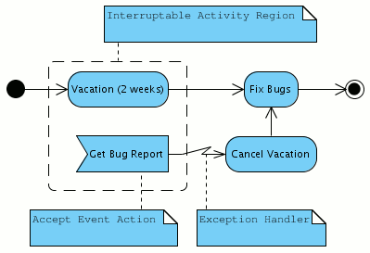
Interrupting an Activity
 Longer running processes can be interrupted by an event - an accept event action within
an interruptable activity region:

Slide 66
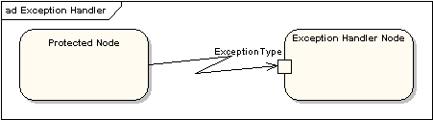
Exception Handling
 Exception Handlers can be modeled on activity diagrams as in
the example below
The exceptions in the activity diagrams are the events or actions that occur during the execution of a program that interrupts the normal execution.

Slide 67
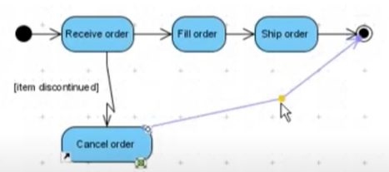

Slide 68
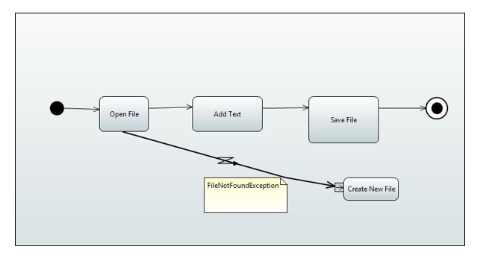

Slide 69
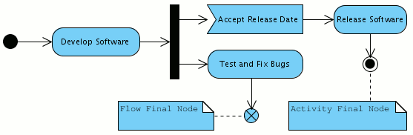
Ending a Flow
 Reaching a flow final node ends a flow (not the activity). The following diagram models a scenario in which software is tested and bugs are fixed - until the release date is due:

Slide 70
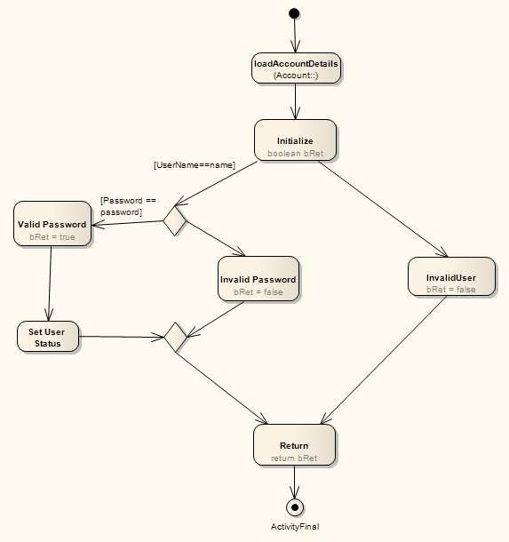
Conditional Statements

Slide 71
Conditional Statements
public boolean doValidateUser(String Password,String UserName)
{
loadAccountDetails();
boolean bRet;
if (Username==name)
{
if (Password == password)
{
bRet = true; bValidUser = true;
}
else
{
bRet = false;
}
}
else
{
bRet = false;
}
return bRet;
}

Slide 72
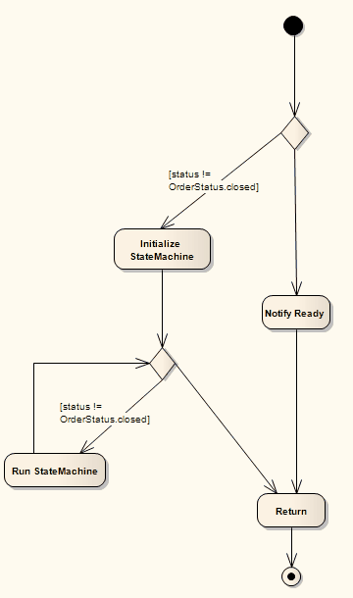
Loops

Slide 73

















Loops
public void doCheckForOutstandingOrders()
{
if (status != closed)
{
initializeStateMachine(); while (status != closed)
{
runStateMachine();
}
}
else
{
//No Outstanding orders;
}
return;
}

